Slide 1
Digital Portfolio
STUDENT NAME: R. Harshini
REGISTER NO AND NMID: 24131061802522023 AND 235D0EFDF2D6205A69C4787645A3FC1F
DEPARTMENT: B.Sc Computer Science (II Year)
COLLEGE: COLLEGE/ UNIVERSITY: Shree Raghavendra Arts and Science College
Keezhamoongiladi, Affiliated to Annamalai
University, Chidambram

Slide 2
PROJECT TITLE
“Design and Development of a Digital Portfolio Website”

Slide 3


AGENDA
Problem Statement
Project Overview
End Users
Tools and Technologies
Portfolio design and Layout
Features and Functionality
Results and Screenshots
Conclusion
Github Link
3/21/2024 Annual Review

Slide 4

PROBLEM STATEMENT
In today’s digital world, having an online portfolio is essential for students to showcase their skills, projects, and achievements. Traditional resumes are static, whereas digital portfolios allow interactive, visually appealing, and accessible self-presentation.

Slide 5

PROJECT OVERVIEW
This project is a Digital Portfolio Website designed using HTML, CSS, and JavaScript.
It highlights personal details, skills, hobbies, and academic projects in a clean, user-friendly design.

Slide 6

WHO ARE THE END USERS?
Students who want to showcase their academic and project work
Recruiters & employers looking for candidate profiles
Teachers & mentors for project evaluation
General audience exploring student achievements

Slide 7

TOOLS AND TECHNIQUES
HTML5 – Structure of the webpage
CSS3 – Styling and responsive design
JavaScript – Interactivity
VS Code – Development environment
GitHub – Hosting and version control

Slide 8
POTFOLIO DESIGN AND LAYOUT
Header & Navigation Bar – Quick links to Home, About, Projects
Home Section – Introduction with name & tagline
About Section – Educational background, skills, hobbies
Projects Section – Mini project details with descriptions
8

Slide 9
FEATURES AND FUNCTIONALITY
Responsive and clean UI
Easy navigation with links to different sections
Skills and hobbies highlighted
Showcases mini projects (Portfolio & To-Do List App)
Interactive and engaging design

Slide 10
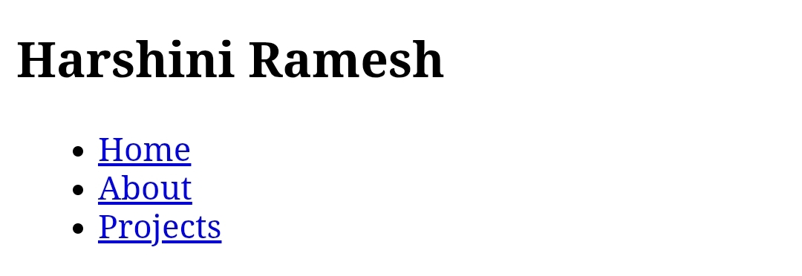

RESULTS AND SCREENSHOTS
3/21/2024 Annual Review
10

Slide 11
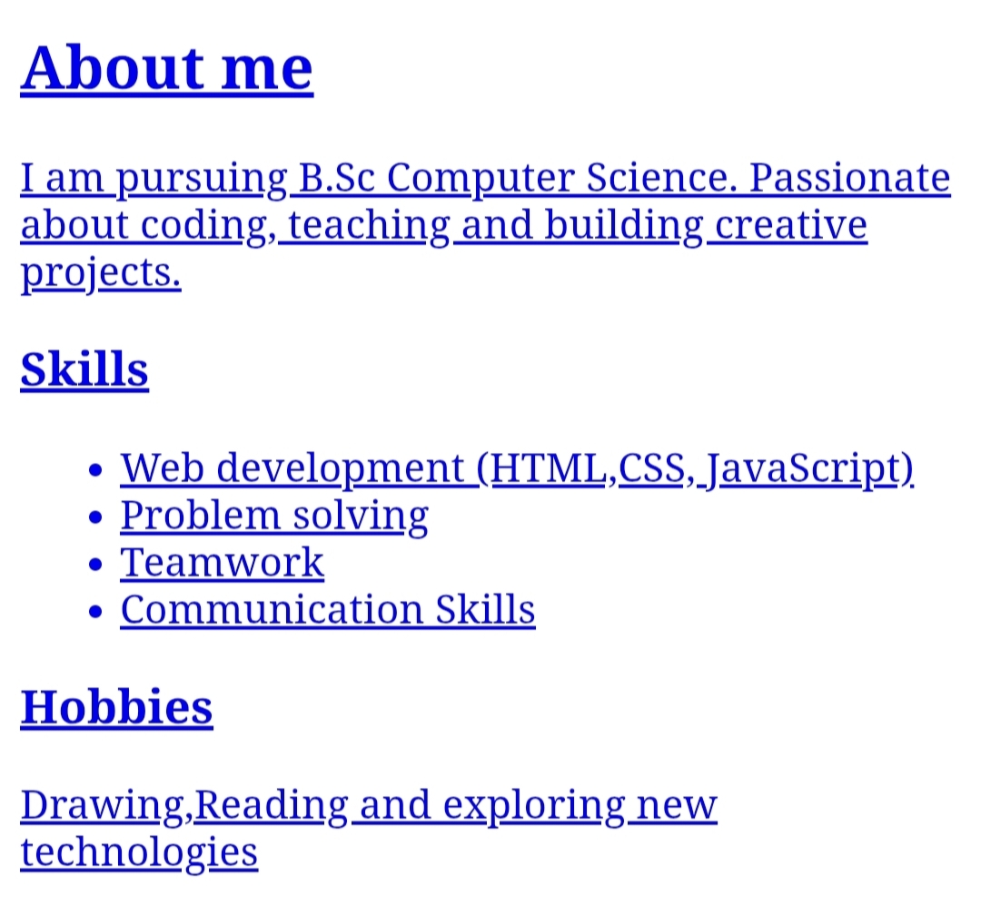
Result and Screenshot

Slide 12
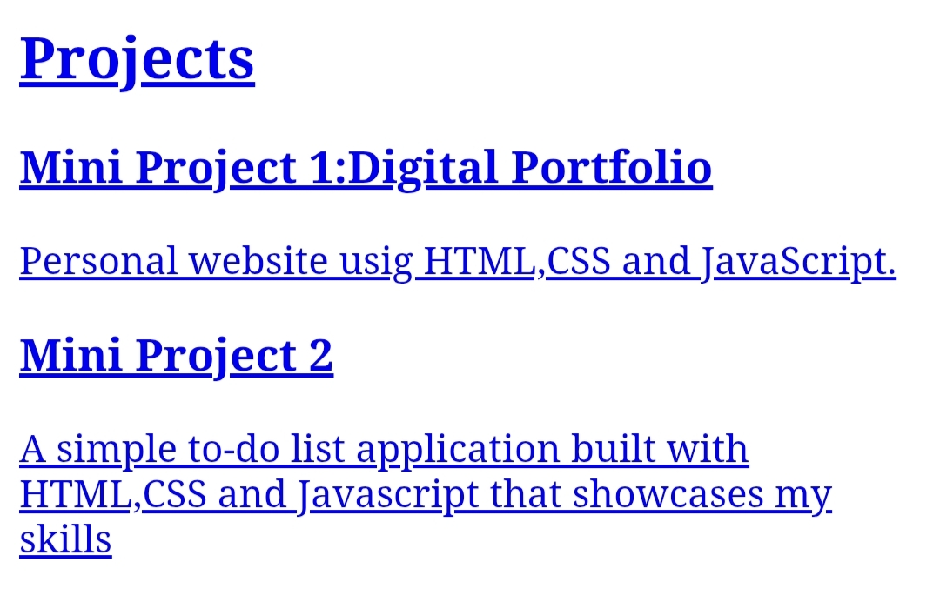
Result and Screenshot

Slide 13
CONCLUSION
The Digital Portfolio successfully demonstrates the use of web development technologies to create a professional online presence. It helps in showcasing skills, projects, and personal interests in a modern and accessible way.
13

Slide 14
GitHub link
https://github.com/harshini12082007/Harshini-TNSDC-FWD-DP

